Slide 1


Name of Project
Air Quality Prediction in Urban Areas
DHARSHAN C
NAVEEN KUMAR P
SHARFUDEEN S
VETRIVEL D
TARANISH BABU S

Slide 2
Content
Abstract
Problem Statement
Objective
Data Collection and Preparation
Proposed Solution (Methodology)
Model Performance Evaluation
Screenshots / Demonstration (video)
Future Scope
Conclusion
Notes:
Abstract
Problem Statement (Clearly define the challenge)
Objective (State your project's goal)
Background and Research (Discuss existing solutions, trends, and gaps)
Data Collection and Preparation (Focus on data sources, cleaning, and augmentation)
Proposed Solution (Methodology)
Model Architecture (e.g., CNN, U-Net, YOLOv5)
Key Techniques (e.g., Transfer Learning, Image Augmentation)
Model Performance Evaluation
Metrics (Accuracy, Precision, Recall, IoU, etc.)
Graphs (Confusion Matrix, ROC Curve, etc.)
Screenshots / Demonstration (Visual proof of system functionality)
Future Scope (Improvements, scalability, and integration ideas)
Conclusion (Summarize results and impact)
Q&A Session

Slide 3
Abstract
Air pollution is a critical issue affecting urban populations.
Traditional monitoring systems are limited by sensor availability and real-time data constraints.
AI models can enhance predictions by integrating air quality, traffic, and weather data.
Example: AI models used in Delhi helped predict air quality levels 24 hours in advance, enabling proactive measures.

Slide 4
Problem Statement
Why is air pollution a problem?
Public health risks (respiratory diseases, cardiovascular issues).
Environmental damage and reduced visibility.
Challenges:
Limited real-time air quality monitoring.
Need for proactive predictions to mitigate health impacts.

Slide 5
Objective
Develop a predictive AI model for air quality forecasting.
Utilize traffic and weather data to enhance prediction accuracy.
Provide actionable insights to city planners and residents.

Slide 6
Data Collection and Preparation
Dataset Details:
Air quality metrics: PM2.5, PM10, NO2, CO.
Traffic data: Vehicle count, average speed.
Weather conditions: Temperature, humidity, wind speed, precipitation.
Data Preprocessing:
Handle missing values.
Normalize numerical features.
Train-test split for model validation.

Slide 7
Proposed Solution (Methodology)
Machine Learning Approach:
Support Vector Machine (SVM) Regression.
Feature selection: Traffic, weather, and air quality data.
Data scaling using StandardScaler.
Implementation Workflow:
Data Cleaning & Preprocessing.
Feature Engineering.
Model Training & Evaluation.
Prediction & Visualization.

Slide 8
Model Performance Evaluation
Evaluation Metrics:
Mean Absolute Error (MAE)
Root Mean Squared Error (RMSE)
Results:
MAE: (Insert result from model)
RMSE: (Insert result from model)

Slide 9
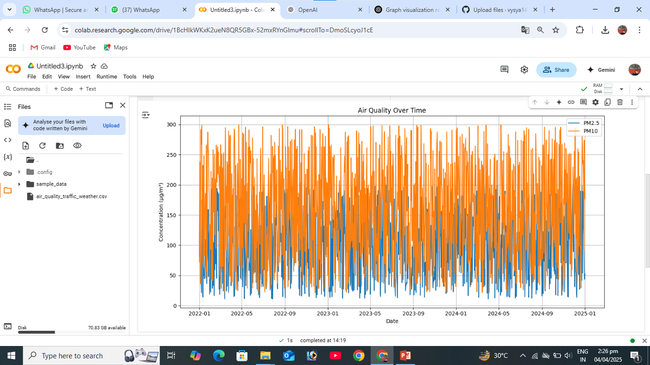
Screenshots / Demonstration (video)
COLAB LINK: https://colab.research.google.com/drive/1BcHIkWKxK2ueN8QR5GBx-52mxRYnGlmu#scrollTo=DmoSLcyoJ1cE
GITHUB : https://github.com/vysya143/S4F_CP_Team_12247

Slide 10
Future Scope
Improve prediction accuracy by incorporating deep learning models.
Expand dataset to include real-time IoT sensor data.
Develop a user-friendly mobile/web application for real-time air quality alerts.
Collaborate with environmental agencies for policy recommendations.

Slide 11
Conclusion
AI-based air quality prediction enhances urban air pollution management.
SVM model shows promising results in forecasting PM2.5 levels.
Future improvements can make predictions more reliable and actionable.

